Slide 1
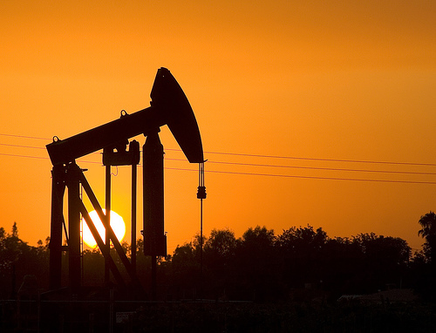
Oil Physical & Financial Markets:
Economics, Engineering, Pricing, and Regulations
Created By Kevin P. Kane

Slide 2
CONTENT
I
Background
II
Oil Physical Fundamentals
III
Derivatives
IV
Oil Futures Fundamentals
V
Speculation Debate
VI
New CFTC Rules
VII
Conclusion

Slide 3
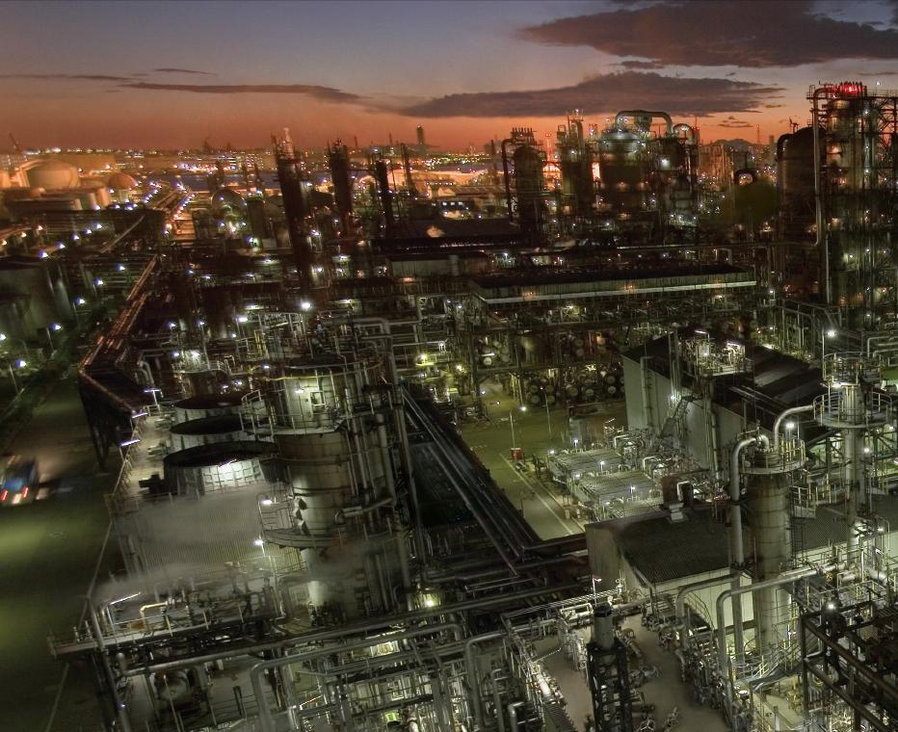
Background
I
A
Oil Prices

Slide 4
Background
I
D₂
Oil Supply and Demand Shifts: 1998 -2008
O_{p}
D₁
D₃
S₂
(2008) $100
Average Annual Real Price
(2009) $50
3
S₁
4
(1998) $20
2
1
P_{o}
A
Oil Prices
Notes:
Source: Prices from BP Statistical Review

Slide 5
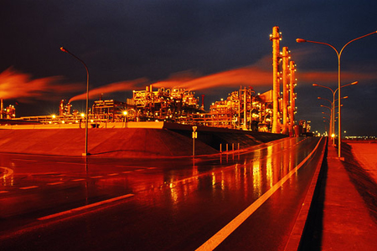
Oil Physical Fundamentals
II
Oil Supply Concerns
$70 per barrel to receive same profit as $30 per barrel several years ago
60% of all new oil discoveries are offshore
Inexpensive Recoverable Oil Gone. Capital Intensive Oil Remaining
이연희
Crude Quality Decreasing (API & Sulfur) – Refinery Margin Decreasing
Excess Capacity Almost Exceeded in 2008. New Production Growth Slow
Expected 2030 Demand Creates Uncertainties in Supply
09-2008 drop in price largely reflected drop in demand
Optimists and Pessimists Politicize Oil Price Debate
BACKGROUND
Notes:
Sources:
$70 per barrel: Ferdinand Banks, Economic Theory and Oil: A Modern Survey, (2008) 16.
Offshore percentage: Ferdinand Banks, The Political Economy of World Energy: An Introductory Textbook, (Singapore: World Scientific Publishing Co., 2007), 36.
Crude Quality: U.S. Department of Energy, Energy Information Administration, “Crude Oil Input Qualities,”
http://tonto.eia.doe.gov/dnav/pet/pet_pnp_crq_dcu_nus_m.htm (accessed April 10, 2009).
(4) 2030 Demand: International Energy Agency “IEA Forecasts Energy Demand to Increase 1.6 percent a Year Through 2030,” International Agency on the Web, November 13, 2008. http://www.prlog.org/
10141086-iea-forecasts-energy-demand-to-increase-16-percent-year-through-2030.html (accessed
November 14, 2008) Quoted in PRLog Free Press Release on the web

Slide 6
Oil Physical Fundamentals
II
Price Discovery: Firms, Fundamentals, & Distortions
Firm Level
Economic Level
Distortion Level
E&P Firm Costs
Exploration
Development
Production
Upstream Factors
Geology
Drive Mechanism
Recovery Factor
Reserve Classification
R/q Ratio
Downstream Factors
Refinery Capacity
Refinery Margin
API – Sulfur Content
Demand
World GDP
Inventory vs. Reserve
Short Term Inelasticity
Expected Demand
Supply
Production
Excess Capacity
Proved vs. Probable
Offshore vs. Onshore
Inelasticity
Interest and Ex Rates
∆R → ↑ or ↓O_{p}
↓$→↑$_{ex} →↑C_{f}→↑O_{dw}
↓$ →↓O-Exp_{pp}→↑S_{cut}
Supply Side
Concerted Production
Collusion
Demand Side
Subsidies
Price Ceiling
MS Expansion
Uncertainty – Politics
Supply Disruption
Nationalization
Transit Monopolies
Nationalization
Three Aspects Reviewed

Slide 7
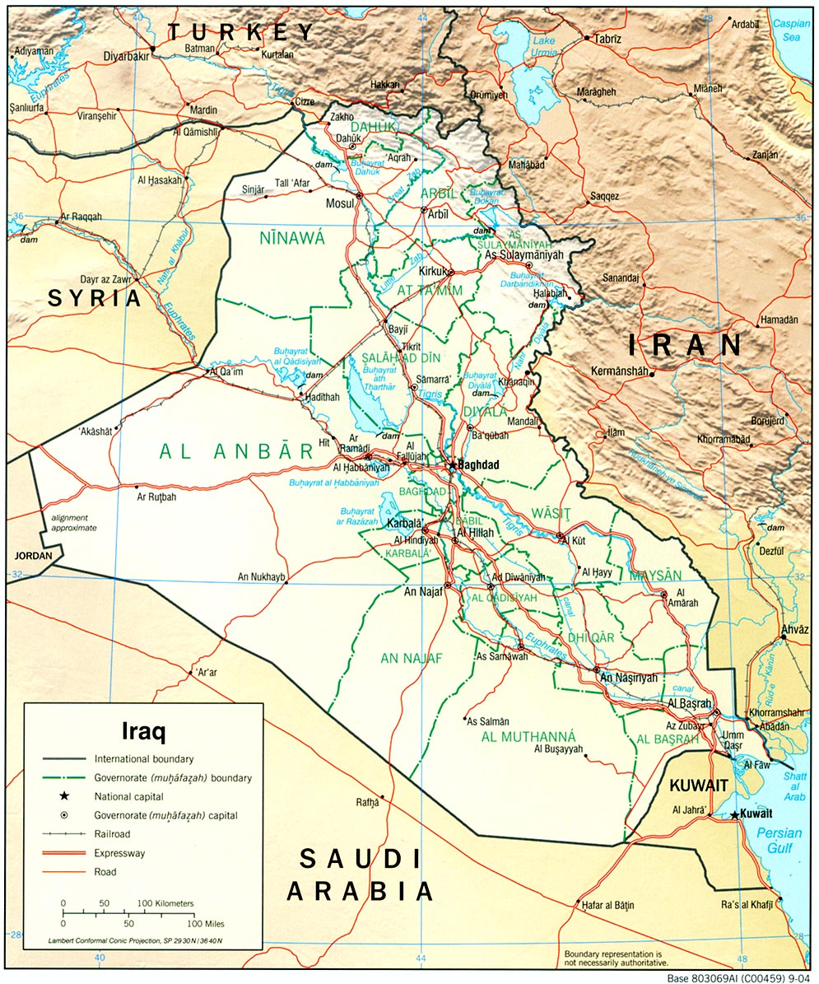
Oil Physical Fundamentals
II
Proved Reserves (≥ 90)
Reserves which on the available evidence are 90% certain to be
technically and economically producible
Seismic Survey & Soil Sample
Probable Reserves (> 50%)
Reserves which are not yet proven but which are estimated to have
greater than 50% chance of being technically & economically producible
Seismic Survey & No Soil Sample
Possible Reserves (< 50%)
Reserves which at present cannot be regarded as probable but which are
significant but less than 50% chance of being technically producible
Seismic Survey & Soil Sample
Firm Level – Understanding Definitions
Notes:
Sources:
“Estimation and Classification of Reserves of Crude Oil, Natural Gas, and Condensate.” Society of Petroleum Engineers. Chapman Cronquist.
The process of moving a reserve classified as possible to probable simply involves drilling and sampling the oil in order to verify the estimates made from a seismic test. Companies do not make the first drill, known as a “Wild Cat,” until there is an economic incentive to do so. When companies report known oil reserves, they only include “proven reserves,” which means that the “recoverable oil” (reserves) may be larger than reported.

Slide 8
Oil Physical Fundamentals
II
Reserves Are NOT SUPPLY – Expected Incremental Supply
Example of Remaining Oil
Reserves if Produced to this point
Q
Q = Liquid Hydrocarbons Produced
Est. Q_{EL}
Unrecovered Oil
Time
Q_{EL} = Economic Limit where if one goes below this line they
do not sell enough to cover their operating costs
30% to 90% of Oil in Place (OIP) is Left in the Ground
R/q Critical Ratio (15-10) equally important as MC & S&D in Determining Production Levels
Firm Level - Reservoir Economics
Notes:
Sources:
“Estimation and Classification of Reserves of Crude Oil, Natural Gas, and Condensate.” Society of Petroleum Engineers. Chapman Cronquist.
For Graph. Kevin’s Petroleum Engineering class notes

Slide 9
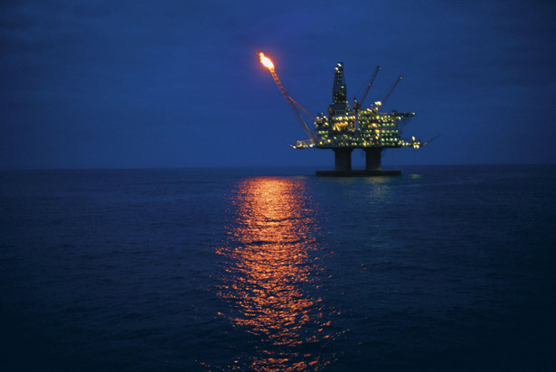
Oil Physical Fundamentals
II
Saudi Arabia Conspiracies Debunked: Water Drive and Conning
Natural Drive Type
Recovery Percentage
Oil
Natural Gas
Oil Expansion 2 to 5
Gas Expansion 70 to 95
Solution Gas 10 to 30
Gas Cap 20 to 50
Pay Zone
Water Drive 20 to 50 45 to 70
Gas Cap
Water
Gravity Segregation 30 to 70
Surface
Derrick
Firm Level - Natural Drive / Recovery
Notes:
Sources:
“Estimation and Classification of Reserves of Crude Oil, Natural Gas, and Condensate.” Society of Petroleum Engineers. Chapman Cronquist.
The process of moving a reserve classified as possible to probable simply involves drilling and sampling the oil in order to verify the estimates made from a seismic test. Companies do not make the first drill, known as a “Wild Cat,” until there is an economic incentive to do so. When companies report known oil reserves, they only include “proven reserves,” which means that the “recoverable oil” (reserves) may be larger than reported.

Slide 10
Oil Physical Fundamentals
II
Recovery Estimation Methods
Oil in Place
Total hydrocarbon content in an oil reservoir, referred to as Stock Tank Original Oil In Place (STOOIP)
= Bulk (rock) volume (acre-feet or cubic meters)
= Fluid-filled porosity of the rock (fraction)
= Water saturation - water-filled portion of this porosity (fraction)
= Formation volume factor (dimensionless factor for the change in volume between reservoir and standard surface conditions)
Volumetric Method
Material Balance
Decline Curve Analysis
Estimation is not an exact science and is subject to potential abrupt changes in
expected recovery and production levels: changes in pressure, water entry, et al.
Recovery of Oil: Delicate Business
Notes:
Sources:
“Estimation and Classification of Reserves of Crude Oil, Natural Gas, and Condensate.” Society of Petroleum Engineers. Chapman Cronquist.
Wikipedia:

Slide 11
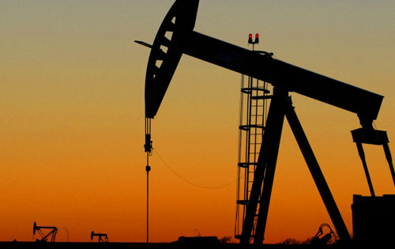
Oil Physical Fundamentals
II
Primary Recovery – Sucking & Pulling
Sucker Rod Pumps, Plunger Lift Pumps, Hydraulic Lift Pumping, Progressing Cavity Pumps, Gas Lift Pumps, Electric Submersible Pumps (ESPs)
Secondary Recovery – Increase Reservoir Pressure
Water Flooding (Most Common), Gas Reinjection
Enhanced Oil Recovery (EOR)– Tertiary Production
Create Fractures (Permeability) & Pumping Inert Gas (Displacing Oil) & Lowering Viscosity
Hydraulic Fracturing, Acid Fracturing, Miscible Fracturing, Thermal Recovery, Chemical Flooding, In-Situ Combustion, Microbial EOR
Firm Level - Natural Drive – Recovery Factor

Slide 12
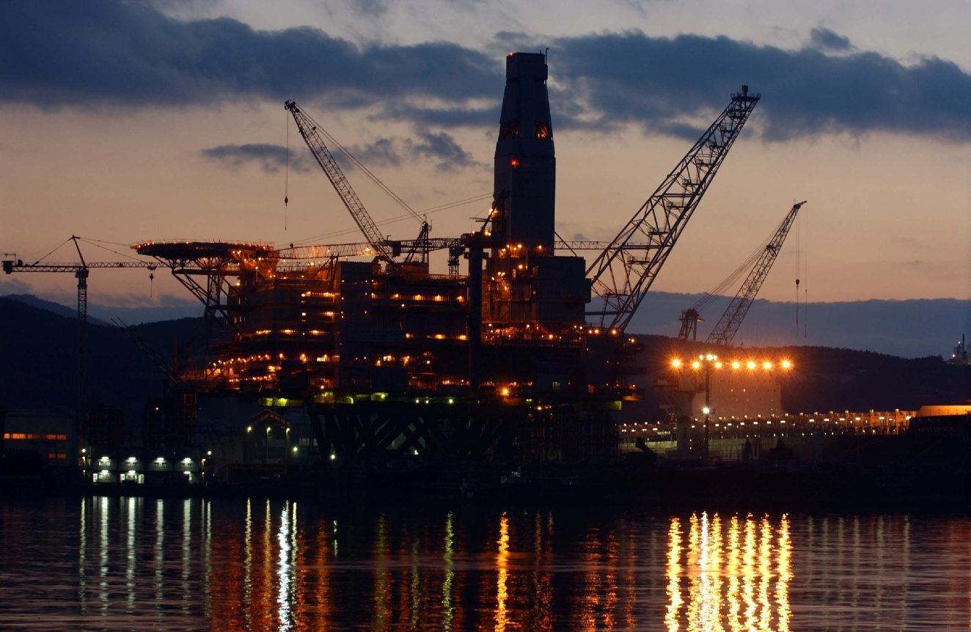
Oil Physical Fundamentals
II
Two Factors
API Gravity (Specific Gravity
Measure of the relative Density of Oil (Higher Figure = Better)
Sulfur Content
Tell us how much Sulfur will need to be separated from the oil
Firm Level – Changing Oil
Notes:
Sources:
Wikpedia: http://en.wikipedia.org/wiki/API_gravity
American Petroleum Institute)

Slide 13
Oil Physical Fundamentals
II
Decreasing Quality
Firm Level: Crude Quality & Yields

Slide 14
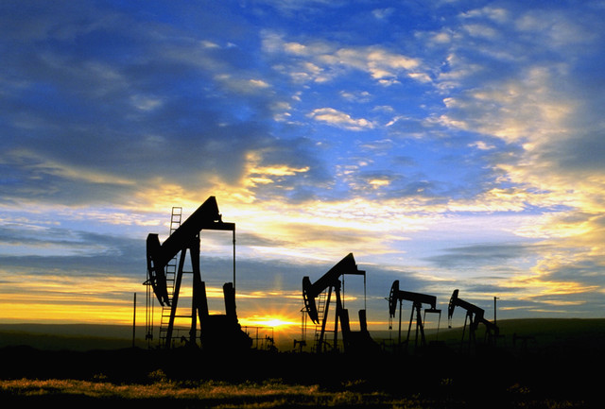
Oil Physical Fundamentals
II
CRUDE TYPES
CHARATERISTICS
YIELDS
US REFINERY
SWEET CRUDE
(Bonnie Light)
34 + API
<0.5% Sulfur
Inexpensive to Refine and Sold at a High Price
3%
8% Propane/Butane
30%
34%
33%
49% Gasoline: Conventional, CARB, Premium
MEDIUM SOUR CRUDE
(Mars, Basrah, Arab Medium)
24 - 34 API
> 1.0 % Sulfur
More expensive than “Sweet” to refine and sold for less
3%
22%
26%
50%
32% Distillate: Jet Fuel, Diesel, Heating
HEAVY SOUR CRUDE
(Maya, Ratawi, Venezuela)
< 24 API
> 1.0 % Sulfur
Least Ideal
1%
14%
11% Heavy Fuel Oil & Other
22%
63%
Firm Level: Refinery Crude Yields
Notes:
Sources:
(1) “Environmental Challenges Panel Refiner Overview API Tanker Conference” Ken Applegate. Published at the American Petroleum Institute
Ken Applegate, VP Transportation Services
Valero Marketing and Supply

Slide 15
Oil Physical Fundamentals
II
Economic Level: Investment Trends
Notes:
Data from Google: http://www.google.com/finance?q=NYSE:BP&fstype=ii

Slide 16
Oil Physical Fundamentals
I
Declining either because of E&P ROI from 1990s, or increasing MC from offshore
Economic Level: Investment Trends
Notes:
FRS = Financial Report System – DOE EIA
Major Companies Surveyed
Alenco Inc.
Exxon Mobil Corporation
Amerada Hess Corporation
Lyondell Chemical Corporation
Anadarko Petroleum Corporation
Marathon Oil Corporation
Apache Corporation
Motiva Enterprises, L.L.C.
BP America, Inc.
Occidental Petroleum Corporation
Chesapeake Energy Corporation
Shell Oil Company
Chevron Corporation
Sunoco, Inc.
CITGO Petroleum Corporation
Tesoro Petroleum Corporation
ConocoPhillips Company
The Williams Companies, Inc.
Devon Energy Corporation
Total Holdings USA, Inc.
El Paso Corporation
Valero Energy Corp
EOG Resources, Inc
XTO Energy, Inc.
Equitable Resources, Inc.

Slide 17
Oil Physical Fundamentals
I
D₂
Impact of Cross Oil Price Elasticity of Energy R&D Demand
O_{p}
D₁
D₃
S₂
P & D Investment, Exp?
(2008)
$100
(2009)
$50
S₁
3
4
2
(1998)
$20
Est. One + Year Lag
1
(2009)
(2010)
(1999)
Economic Level: Investment Trends
Notes:
FRS = Financial Report System – DOE EIA
Major Companies Surveyed
Alenco Inc.
Exxon Mobil Corporation
Amerada Hess Corporation
Lyondell Chemical Corporation
Anadarko Petroleum Corporation
Marathon Oil Corporation
Apache Corporation
Motiva Enterprises, L.L.C.
BP America, Inc.
Occidental Petroleum Corporation
Chesapeake Energy Corporation
Shell Oil Company
Chevron Corporation
Sunoco, Inc.
CITGO Petroleum Corporation
Tesoro Petroleum Corporation
ConocoPhillips Company
The Williams Companies, Inc.
Devon Energy Corporation
Total Holdings USA, Inc.
El Paso Corporation
Valero Energy Corp
EOG Resources, Inc
XTO Energy, Inc.
Equitable Resources, Inc.

Slide 18
Oil Physical Fundamentals
II
Cutting Production when price falls is natural economic behavior
due to marginal costs—something not specific to only OPEC
Economic Level: Production & Marginal Costs

Slide 19
Oil Physical Fundamentals
II
Critical & Unique Period for Low Spare Capacity due to Expected Demand
Spare Capacity – Production – Reserve Discovery - Exchange Rates
이연희
Marginal Costs - Risk - World GDP
Economic Level: Spare (Excess) Capacity
Notes:
Sources:
Wikpedia: http://en.wikipedia.org/wiki/API_gravity
American Petroleum Institute)

Slide 20
Oil Physical Fundamentals
II
Economic Level: Supply & Demand

Slide 21
Oil Physical Fundamentals
II
More Inelastic
Why?
China’s Fuel Subsidies are 1% of GDP, “Morgan Stanley”
Economic Level: Inelastic Demand
Notes:
Source of China’s Subsidies: http://www.nytimes.com/2008/06/04/business/worldbusiness/04iht-rtrcol05.1.13452490.html?_r=1
http://www.rigzone.com/news/article.asp?a_id=51744

Slide 22
Oil Physical Fundamentals
I
Economic Level: Oil Priced in Dollars

Slide 23
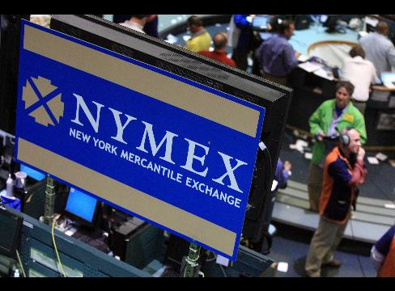
DERIVATIVES
III
Derivatives: Futures & OTC
Hedge Risk Contracts For Future Price:
Futures, Credit Default Swaps, Interest Rates, Exchange Rates, OTC, et al.
Calls, Puts, Premium: $300 Trillion Dollar Market
Over-The-Counter (OTC) Derivatives
Derivatives Traded Between 2 Parties Outside of “Transparent, Organized Market
Structures” such as NYMEX—a central exchange or trading venue.
Commodity Swap Dealers offer tailored swap contracts to client OTC
Markets. Limiting unmatchable contract exposure requires futures markets
Clearing Houses
Clear the agreement to accept a future delivery of oil through a futures contract
Often settled in cash rather than physical delivery. 03–08 only 2% physical delivery
Hedging Risk
Notes:
Sources:
(1)Testimony of Chairman Gary Gensler Before the House Committee on Energy and Commerce, Subcommittee on Energy and Environment, December 2, 2009
(2) Interim Report on Crude Oil: Interagency Task Force on Commodity Markets - http://www.cftc.gov/ucm/groups/public/@newsroom/documents/file/itfinterimreportoncrudeoil0708.pdf

Slide 24
Oil Futures Fundamentals
IV
Oil Futures
Price Discovery
Short & Long Term
Trader Classifications
Position Limit
CFTC
Notes:
FRS:

Slide 25
Oil Futures Fundamentals
IV
Futures Market – NYMEX (DCM), ICE (ECM)
A Contract to Receive Delivery of a Commodity at a Future Date:
Paper Oil – less than 1% Physical
“In first 10 months of 2009, more than 114 million (114 billion barrels at $1.6 Trillion
dollars) WTI contracts were traded on CFTC-regulated exchanges.” Gary Geisler
Primary Functions
Price Discovery
Information Sharing and Equilibrium – one world oil price
One countries oil supply gain, is everyone’s gain
Economics of Futures
A Forward Curve
Contango versus Backwardation
Intermonth Spread (Switch) – Full Carry + Forward Curve (In Contango)
Oil Futures Market
Notes:
Sources:
(1)Testimony of Chairman Gary Gensler Before the House Committee on Energy and Commerce, Subcommittee on Energy and Environment, December 2, 2009
(2) Interim Report on Crude Oil: Interagency Task Force on Commodity Markets - http://www.cftc.gov/ucm/groups/public/@newsroom/documents/file/itfinterimreportoncrudeoil0708.pdf

Slide 26
Oil Futures Fundamentals
III
Oil Futures Market
Notes:
Source: Oil 101, by Morgan Downey

Slide 27
Oil Futures Fundamentals
IV
Commercial Traders
Hedgers
Commercial Interests. If one holds physical inventory but does not hedge by going
short, will with hold downward pressure on prices
Non-Commercial Traders
Speculator 1: Scalpers or Market Makers
Operate Shortest Horizon, sometimes trading within seconds. Do not trade with a view of where prices are going. CFTC Interim Report
Speculator 2: View of Long Term
Anticipate prices in minutes, hours, days, weeks, or months = make price discovery
Oil Futures Market
Notes:
(1) Interim Report on Crude Oil: Interagency Task Force on Commodity Markets - http://www.cftc.gov/ucm/groups/public/@newsroom/documents/file/itfinterimreportoncrudeoil0708.pdf

Slide 28
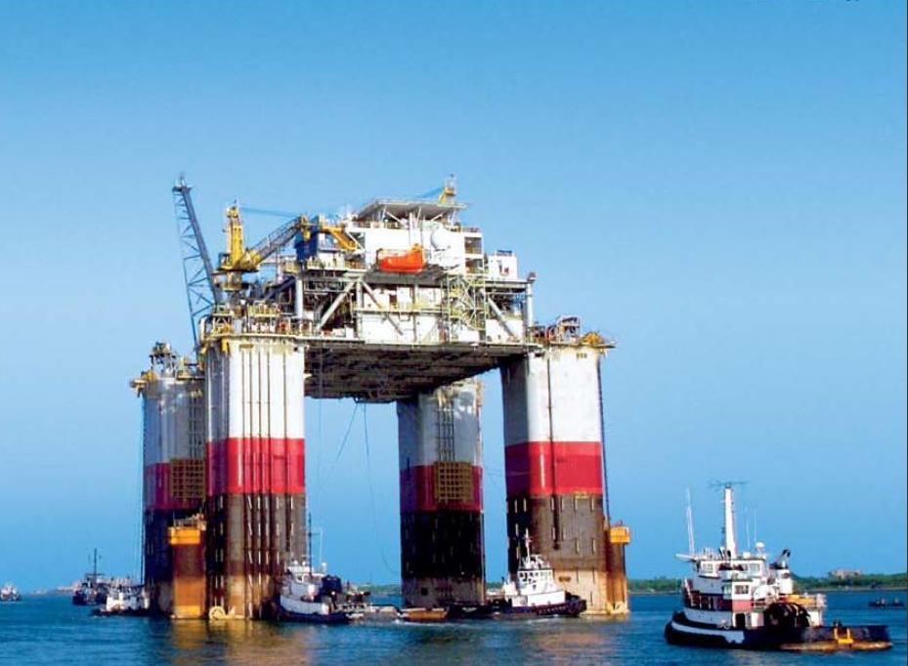
Oil Futures Fundamentals
III
REGULATORS
CFTC: Commodity Futures TRADING Commission
Regulating Certain Markets for Risk Management Contracts (Derivatives)
COT Report
CFTC Publishes every Friday at 3:30 PM Eastern Time. 90% of all Open Interests! Contains a summary of traders’ positions as of the close of business on previous Tuesday for each market in which 20 or more traders hold positions equal to or above the large trader reporting levels established by the CFTC
Oil Futures Market
Notes:
CFTC.gov

Slide 29
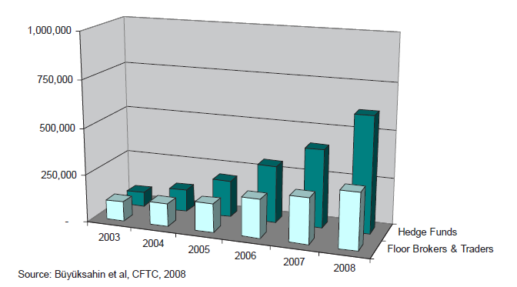
Speculation Debate
V
WTI Average Open Interest by Non-Commerical Participants, 2003-2008
Investment Banks & Speculation
Notes:
Source: CFTC Interim Report

Slide 30
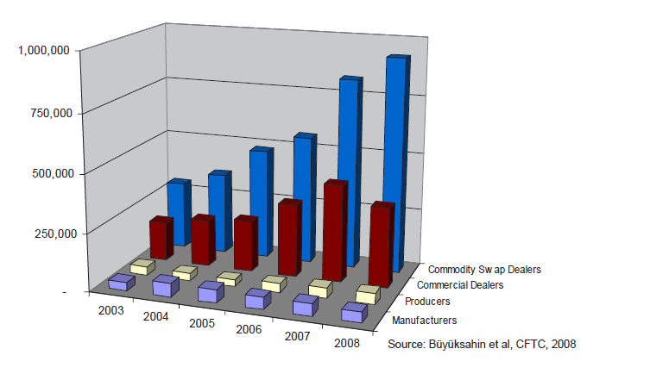
Speculation Debate
V
WTI Average Open Interest by Commercial Participants, 2003-2008
Investment Banks & Speculation
Notes:
Source: CFTC Interim Report

Slide 31
Speculation Debate
V
Long Positions & Oil Prices
Notes:
Source:
Petronet.com Datasets on Futures Contracts
DOE EIA WTI Data with St. Louis Fed CPI Data
And…
http://www.marketwatch.com/story/goldman-sachs-raises-possibility-of-200-a-barrel-oil
http://www.cnsnews.com/news/article/55377
"As the lack of supply growth and price-insulated non-OECD demand suggest a future rebound in U.S. gross domestic product growth or a major oil supply disruption could lead to $150-$200 a barrel oil prices," Goldman said.

Slide 32
Speculation Debate
V
No effect of Goldman Sachs March 2007 $200 Prediction. Reasonable prediction if a War with Iran broke out!
Long and Short Positions & Oil Prices
Notes:
Source:
Petronet.com Datasets on Futures Contracts
DOE EIA WTI Data with St. Louis Fed CPI Data
And…
http://www.marketwatch.com/story/goldman-sachs-raises-possibility-of-200-a-barrel-oil
http://www.cnsnews.com/news/article/55377
"As the lack of supply growth and price-insulated non-OECD demand suggest a future rebound in U.S. gross domestic product growth or a major oil supply disruption could lead to $150-$200 a barrel oil prices," Goldman said.

Slide 33
Speculation Debate
V
Oil Price Schools of Thought & Primary Players
Oil Prices 04-08
Increase Arguments
Fundamentals
Speculators
Optimists
Oil Peakers
Governments
Downstream Lobbyists
Demand & Supply
Reserves/ Discovery Declining
Marginal Costs
Distortions
Excess Capacity
US Fed Rate - $ Value
Speculation
US, JP, KR
EU
Oil Peak
0
KEY
Accept
Partially Accept
Reject
Oil Prices, Bias, and Political Lenses
Notes:
(1) Fundamentals represents those who attribute the 2004 to 2008 rise in oil prices to fundamentals, with the two divisions, oil peak theorists and optimists.
(2) Speculators represents the two groups arguing that speculation caused the 2004 to 2008 oil price increases to speculation, with governments and downstream industries representing different divisons.
Source: My own Analysis!

Slide 34
SPECULATION DEBATE
V
INTERESTS
Oil Producers
Oil Traders
(1) Want to cover MC and generate
capital for investment.
(2) Want to avert demand destruction
(1) Hedge Risk
(2) Price Discovery
(3) Speculators: Price Changes
Truth?
Dishonest Governments
Honest Governments
(1) Realize Low Prices
(2) Sustain Popularity
(3) Show people they are doing something
(1) Long Term View of Oil & Energy
(2) Change Consumer Behavior
(3) Sustain Globalization
0
Where is the Absolute Answer to Oil Prices?
Notes:
Citation:
(1) http://www.heatingoil.com/blog/9898104/
(2) James D. Hamilton, Causes and Consequences of the Oil Shock of 2007-08*

Slide 35
SPECULATION DEBATE
V
SPECULATION EVIDENCE
CFTC Chief Economist
Speculation
Evidence
Jeffrey Harris, Chief Economist at the CFTC, quit his post in January after
finding no evidence that speculation played a role in driving up oil
prices.
James Hamilton, Economist
Speculation
Evidence
Low Price Elasticity coupled with Insufficient Production Increases
caused the 2007 to 2008 price increases rather than speculation
CFTC Officials
Speculation
Evidence
“We do not need to show excessive speculation is affecting prices in
order to approve the rule.”(Position Limits, et al.)
Commodity Trading Regulation
Notes:
Citation:
(1) http://www.heatingoil.com/blog/9898104/
(2) James D. Hamilton, Causes and Consequences of the Oil Shock of 2007-08*

Slide 36
New CFTC Rules
VI
ENACTED REGULATIONS
(H.R. 6124) Farm Bill, 2008
Strengthen CFTC Authority over Futures Market
Enacted
If a contact traded in an Exempt Commercial Market (ECM) is found to
influence price discovery, the ECM is subject to heightened regulation
and to comply with Futures Contract principles
Commodity Trading Regulation
Notes:
Source:
Testimony of Chairman Gary Gensler Before the House Committee on Energy and Commerce, Subcommittee on Energy and Environment, December 2, 2009
CFTC Chairman Gary Gensler Comments on House Passage of H.R. 4173, December 11, 2009
Remarks of Chairman Gary Gensler, “OTC Derivatives Reform”, Council on Foreign Relations, January 6, 2010
Farm Bill: http://www.usda.gov/wps/portal/farmbill2008?navid=FARMBILL2008

Slide 37
New CFTC Rules
VI
PROPOSED REGULATIONS
Over-The-Counter (OTC) Derivatives
Move To Standard OTC transactions into clearing houses
Supporting
Argument
(1) Wall Street Wide Spreads from Lack of Buyer-Seller transparency
(2) Concentrated with 6 to 15 Institutions worldwide
(3) want to control for potential risks from interconnectedness.
(4) Transparency To Public & Regulatory Body = Better Pricing
Opposing
Argument
Option premium costs change with changes in underlying futures
prices rather than options being a part of price discovery
themselves. So option prices are derived from futures prices rather
than setting futures prices - hence options are called derivatives.”
Morgan Downey, Commodity Trader
Fear vs. Empiricism
Notes:
Source:
Testimony of Chairman Gary Gensler Before the House Committee on Energy and Commerce, Subcommittee on Energy and Environment, December 2, 2009
CFTC Chairman Gary Gensler Comments on House Passage of H.R. 4173, December 11, 2009
Remarks of Chairman Gary Gensler, “OTC Derivatives Reform”, Council on Foreign Relations, January 6, 2010

Slide 38
New CFTC Rules
VI
PROPOSED REGULATIONS
POSITION LIMITS
Proposed
(1) The CFTC Voted 4 to 1 (01-14-10) to put proposal out for 90
day public comment period to cap traders for all-monthly limits at
10% of the open interest of the first 2.5% open interest beyond
25,000. The single-month would limit 2/3 of the aggregate cap
cap traders for all-monthly limits.
(2) Caps Will covering individual exchanges, spot-month contracts,
all-month contracts, and would include a cumulative gap across U.S.
exchanges.
(3) Limits on Who is Exempt (Airliners Exempt) from position limits
Terms Explained
Individual exchanges: ICE and CME separately
Spot month: the month nearest to expiry
All Contract months: all months listed into the future on the futures exchange
Cumulative gap across U.S. exchanges: CME and ICE together
Position Limit: A limit is X futures contracts * 1000 barrels
A Punishment Without a Crime
Notes:
Source: Bloomberg
http://www.bloomberg.com/apps/news?pid=20601130&sid=an4FGruBQwkU
The CFTC Voted 4 to 1 (February 2nd) to put proposal out for 90
day public comment period to cap traders for all-monthly limits at
10% of the open interest of the first 2.5% open interest beyond 25,000.
The single-month would limit 2/3 of the aggregate cap
(2) Limits in spot month would hold investors to 25% of the open
interest in the future for physical delivery. A trader with spot month
cash-settled contracts could hold 5 times as many contracts as long as
they held no physically settled contracts in the spot month

Slide 39
New CFTC Rules
VI
PROPOSED REGULATIONS
POSITION LIMITS
Supporting
Argument
(1) Removes Concentration in Futures Market away from a Few
Major Participants, Including Goldman Sachs.
(2) Curtails Momentum on Long Positions
Opposing
Argument
No evidence concentration of a few players in the futures markets
influences momentum of price discovery into one direction, and
against market principles to suggest that it is inappropriate for a
someone to exercise their right to make money from price changes.
People should not have a natural entitlement to be free from
competition with successful banks. It is not the role of government to
prevent losers in the free market.
Flawed Premise
Notes:
Source: Bloomberg
http://www.bloomberg.com/apps/news?pid=20601130&sid=an4FGruBQwkU
The CFTC Voted 4 to 1 (February 2nd) to put proposal out for 90
day public comment period to cap traders for all-monthly limits at
10% of the open interest of the first 2.5% open interest beyond 25,000.
The single-month would limit 2/3 of the aggregate cap
(2) Limits in spot month would hold investors to 25% of the open
interest in the future for physical delivery. A trader with spot month
cash-settled contracts could hold 5 times as many contracts as long as
they held no physically settled contracts in the spot month

Slide 40
New CFTC Rules
VI
PROPOSED REGULATIONS
HEDGE DISCLOSURE EXEMPTIONS
Proposed
(1) Under the aforementioned February Proposal, Swap Dealers will
No Longer Receive Confidential Hedge Exemptions. This proposal
targets 10 large traders across oil, natural gas, heating oil, and gasoline
markets, some of whom could qualify for exemptions.
(2) Swap Dealers would instead would need “risk management”
exemptions, that would be reviewed monthly by the commission and
made public after six months
Market Intervention
Notes:
Source: Bloomberg
http://www.bloomberg.com/apps/news?pid=20601130&sid=an4FGruBQwkU
The CFTC Voted 4 to 1 (February 2nd) to put proposal out for 90
day public comment period to cap traders for all-monthly limits at
10% of the open interest of the first 2.5% open interest beyond 25,000.
The single-month would limit 2/3 of the aggregate cap
(2) Limits in spot month would hold investors to 25% of the open
interest in the future for physical delivery. A trader with spot month
cash-settled contracts could hold 5 times as many contracts as long as
they held no physically settled contracts in the spot month

Slide 41
New CFTC Rules
VI
PROPOSED REGULATIONS
TRANSPARENCY
Supporting
Argument
(1) Increases Transparency & Reduces Market Information Deficit
for Price Discovery
(2) Increases Public Access to see Scope and Scale of Markets
(3) Eliminates Information Deficit for regulators, allowing them to
gather information necessary to police markets
Opposing
Argument
(1) Since it may not be possible for the OTC market to influence price
discovery, and since their prices are determined by the Futures Market,
the effort will not achieve its insinuated aims. It is misleading to the
public.
(2) The public has no inalienable right to obtain market information
acquired by banks since they invested capital to obtain that information.
The belief that people are entitled to information is flawed.
Immoral Entitlement
Notes:
Source:
(1) Bloomberg
http://www.bloomberg.com/apps/news?pid=20601130&sid=an4FGruBQwkU
(2) Testimony of Chairman Gary Gensler Before the House Committee on Energy and Commerce, Subcommittee on Energy and Environment, December 2, 2009

Slide 42
CONCLUSION
VII
Who is behind high oil prices?
(1) OPEC, Wall Street, Corrupt Banks? No!
(2) Oil Supply & Demand Fundamentals? Yes!
(3) Energy Price Ceilings & Control? Yes!
(4) The Average Consumer? Yes!
(5) Government Social Policies Promoting Demand? Yes!
Cure the Disease, not the Symptom!

Slide 43
CONCLUSION
VII
Oil Prices & Globalization
If the intention of regulation speculators is to appease angry voters or to
suppress oil price, it is wrong, and could lead to a price spike at a later date!
Recognize that in a Financially and Economically Integrated World,
Energy Independence is Impossible!
Denationalize our View of Energy Security & Oil
Oil is Not a Public or National Good
Prioritize Long Term Over Short Term
Educate Populations! Don’t prey on them for Votes!
Banks, OPEC, Oil Companies, are not the source of oil price instability!

Slide 44
CONCLUSION
VII
QUESTIONS?
Drafted and Presented by Kevin P. Kane

